Slide 1
Introduction to Information Systems
What will be covered in this Topic
Definitions and concepts of sytems,information systems.
Components of information systems
Functions of information systems
Role of informations systems in organisations

Slide 2
Objectives
Understand the concept of a system and how it relates to information systems.
Explain why knowledge of information systems is important for business professionals, and identify five areas of information systems knowledge they need.
Give examples to illustrate how the business applications of IS can support a firm’s business processes, managerial decision making, and strategies for competitive advantage
The value of information and how it helps decision makers achieve the organization’s goals.
Distinguish data from information and describe the characteristics used to evaluate the quality of data
Knowing the potential impact of information systems in organizations
Identify the basic types of business information systems

Slide 3
System-Definition
Definitions:
A system is a set of interrelated components With a clearly defined boundary Working together to achieve a common set of objectives.
A system is an orderly grouping of interdependent components linked together according to a plan to achieve a specific objective.
A system is an interrelated set of business procedures (or components) used within one business unit, working together for some purpose.
For example, a system in the payroll department keeps track of pay roll transitions, whereas an inventory system keeps track of supplies. The two systems are separate.

Slide 4
System -Definition
The study of system concepts has three basic implications:
A system must be designed to achieve a predetermined objective.
Interrelationships and interdependence must exist among the components.
The objectives of the organization as a whole have a higher priority than the objectives of its subsystems.

Slide 5
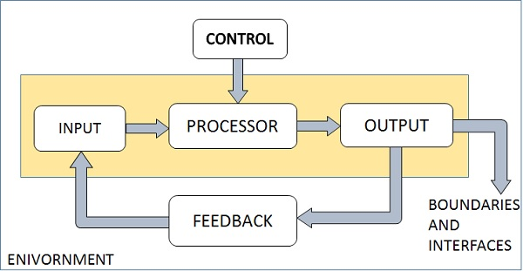
Elements of a system

Slide 6
Elements of a system
A system has three basic elements input, processing and output. The other elements include control, feedback, boundaries, environment and interfaces.
Input: Input is the data the system receives to produce a certain output.
Output: What goes out from the system after being processed is known as Output.
Processing: The process involved to transform input into output is known as Processing.
Control: In order to get the desired results it is essential to monitor and control the input, Processing and the output of the system. This job is done by the control.

Slide 7
Elements of a system cont’d
Feedback: The Output is checked with the desired standards of the output set and the necessary steps are taken for achieving the output as per the standards, this process is called as Feedback. It helps to achieve a much better control in the system.
Boundaries: The boundaries are nothing but the limit of the system. Setting up boundaries helps for better concentration of the activities carried out in the system.
Environment: The things outside the boundary of the system are known as environment. Change in the environment affects the working of the system.
Interfaces: The interconnections and the interactions between the sub-systems is known as the Interfaces. They may be inputs and outputs of the systems..

Slide 8
Characteristics Of A System:
Organization: implies structure and order. It is the arrangement of components that helps to achieve objectives.
Interaction: refers to the manner in which each component functions with other components of the system.
Interdependence: means that parts of the organization or computer system depend on one another. They are coordinated and linked together according to a plan. One subsystem depends on the output of another subsystem for proper functioning.
Integration: refers to the holism of systems. It is concerned with how a system is tied together.
Central Objective: A system should have a central objective. Objectives may be real or stated. Although a stated objective may be the real objective, it is not uncommon for an organization to state one objective and operate to achieve another.

Slide 9
Types of System
Abstract and Conceptual systems
Physical systems
Open and Closed systems
Deterministic or probabilistic systems
Man –made information systems

Slide 10
Types of System
Abstract or conceptual :An abstract or conceptual system is an orderly arrangement of interdependent ideas or concepts, which may or may not have any counterpart in the real world.
Physical system is tangible entities that may be static or dynamic in nature. physical systems are generally actual operational systems made up of people, materials, machines, energy and other physical things; Physical systems are more than conceptual ideas.

Slide 11
Types of System cont’d
An open system continually interacts with its environment. It receives input from the outside and delivers output to outside.
Thus exchanges information, material, or energy with the environment, including random and undefined inputs. Open systems are adaptive in nature, as they tend to react with the environment in such a way, so as to favor their continued existence. Such systems are ‘self organizing’, in the sense that they change their organization in response to changing conditions
A closed system is isolated from environment influences. A closed system is one, which does not interact with its environment.
Such systems in business world, are uncommon, but relatively closed systems are common. Thus, the systems that are relatively isolated from the environment but not completely closed, are termed closed system.

Slide 12
Types of System cont’d
Deterministic and Probabilistic: A Deterministic system is one in which the occurrence of all events is perfectly predictable. If we get the description of the system state at a particular time, the next state can be easily predicted. A probabilistic system is one in which the occurrence of events cannot be perfectly predicted.
Man-made Information System: It is generally believed that the information reduces uncertainty about a state or event. An information system is the basis for interaction between the user and the analyst. It determines the nature of relationship among decision-makers.
An information system may be defined as a set of devices, procedures, and operating systems designed around user-base criteria to produce information and communicate it to the user for planning, control, and performance

Slide 13
Definition of An Information System
  A set of interrelated components that collect, manipulate, and disseminate data and information and provide feedback to meet an objective.
An organized combination of People, Hardware, Software, Communication networks, data resources, Policies, and procedures that stores, retrieves, transforms, and disseminates information in an organization
  People depend on modern IS to communicate with each other using a variety of physical devices (hardware), information processing instructions & procedures (software), communication channels (networks) & stored data (data resources).
An information system (IS) is a set of interrelated elements that:
  Collect (input)
  Manipulate (process)
  Store
  Disseminate (output) data and information
  Provide a corrective reaction (feedback mechanism) to meet an objective

Slide 14
Information systems are combinations of hardware, software, and telecommunications networks that people build and use to collect, create, and distribute useful data, typically in organizational settings.
In our modern life information system is necessary. We can’t pass a day without this. Technology can be thought of as the application of scientific knowledge for practical purposes.

Slide 15
Data, Information and Knowledge
Data: Data are raw facts about physical phenomena or business transactions. Data can be represented in numerous forms. Alphanumeric data e.g. Numbers, Letters & other characters. Image data e.g. graphic images & Pictures Audio, Sound, Voice, Video data
Information: is data that has been converted into meaningful and useful context for end users. Or Collection of facts organized in such a way that they have value beyond the facts themselves
Examples:
  Sales data are the names, quantities, and dollar amounts
  Sales information are the a mount of sales by product type, sales territory, or salesperson
Knowledge: Means awareness and understanding of a set of information

Slide 16
Characteristics Of Good Information
Completeness: Effective Information must present all the most relevant and useful information for a particular decision. It should contain all the facts that are necessary for the decision-makers to satisfactorily solve the problem at hand using such information. Nothing important should be left out. Although information cannot always be complete, every reasonable effort should be made to obtain it.
Timeliness: Information must be delivered at the right time and the right place to the right person. Premature information can become obsolete or be forgotten by the time it is actually needed. Similarly, some crucial decisions can be delayed because proper and necessary information is not available in time, resulting in missed opportunities.

Slide 17
Characteristics Of Good Information
Accuracy: A key measure of the effectiveness of an I.S. is the accuracy of its information. Accurate information helps businesses make the correct decisions. If a sales department sent inaccurate sales figures to the finance department this might result in incorrect profit and/or tax calculations for the company that would put them in danger.
Clarity and concise: Information should be to the point and just enough. It must be understood by the receiver so that he will interpret it correctly. Information that is used for a business purpose needs to be understandable by the end user. He must be able to decode any abbreviations, shorthand notations or any other acronyms contained in the information.
Relevance: Relevant information is information that is directly related to your business need. The information a manager receives from an MIS has to relate to the decisions the manager has to make. For example, if a manager wants a summary of the sales figures for the last 6 months, then the information that has the right level of detail might show the overall sales figures for each month and the grand total added together.

Slide 18
Characteristics Of Good Information
.
Trustworthiness: The information should be counted on to be trustworthy. Obtaining information for a business purpose means that you must obtain it from a reliable and trusted source.
Cost-effective: The information is not desirable if the solution costs more than the problem. The cost of gathering data and processing it into information must be weighed against the benefits derived from using such information.
Accessibility: Accessible information is information that is stored in a way that it can be easily accessed at any time. Information may be useless if it is not readily accessible in the desired form, when it is needed.

Slide 19
Components Of An Information System
The components of an information system work together to provide quality information by
Collecting the Information
Processing the Information
Storing the Information
Retrieving the Information
Disseminating or Sharing the Information
Institutions such as the banks, hospitals, schools, health insurance schemes, Insurance Companies, Airlines, Telecommunication companies, shopping malls, restaurants etc., need this quality information to plan and make decisions.

Slide 20
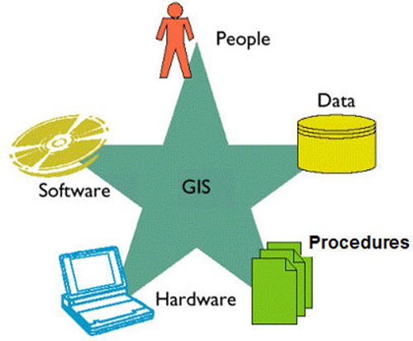
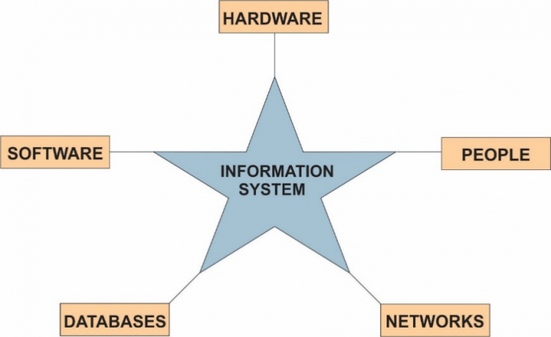
Components Of Information System
These are Hardware, Software , Data, Procedures , People, Networks, Databases

Slide 21
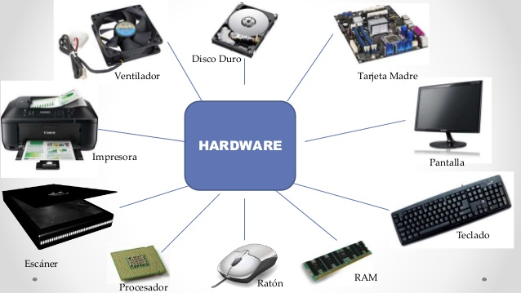
Components Of Information System cont’d
Hardware: These are equipment that are used to collect/input data into system, provide storage and process, the data to create information. Information systems hardware is the part of an information system that can be touched – the physical components of the technology. These are Computers and their components such as, keyboards, disk drives, iPads, and flash drives are all examples of information systems hardware.

Slide 22
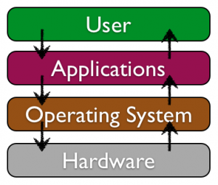
Components Of Information System cont’d
Software
These are Step-by-step set of instructions that convert data into information. Or software is a set of instructions that tells the hardware what to do. Software is not tangible – it cannot be touched. When programmers create software programs, what they are really doing is simply typing out lists of instructions that tell the hardware what to do. There are several categories of software, with the two main categories being operating-system software, which makes the hardware usable, and application software, which does something useful. Examples of operating systems include Microsoft Windows on a personal computer and Google’s Android on a mobile phone. Examples of application software are Microsoft office .

Slide 23
Components Of Information System cont’d
Data
The third component is data. We can think of data as a collection of facts. For example, the street address, the city we live in, and our phone number are all pieces of data. Like software, data is also intangible. By themselves, pieces of data are not really very useful. But aggregated, indexed, and organized together into a database, data can become a powerful tool for businesses. In fact, all of the definitions presented at the beginning of this chapter focused on how information systems manage data. Organizations collect all kinds of data and use it to make decisions. These decisions can then be analyzed as to their effectiveness and the organization can be improved.

Slide 24
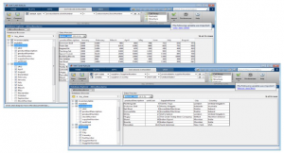
Components Of Information System cont’d
Databases
Softwares that enable storage and retrieval of related information about entities or objects. The software is typically not designed to work with a specific organization or a specific type of analysis rather it is a general-purpose information system.

Slide 25
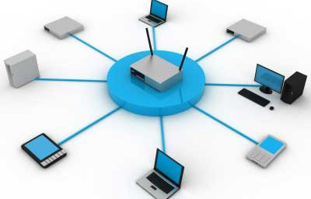
Components Of Information System cont’d
Network
These are computing devices that communicate with each other and enable sharing of information and resources with in information systems

Slide 26
Components Of Information System cont’d
Procedures:
These are rules or guidelines to follow when using Hardware and software.
Procedures are the policies that govern the operation of a computer system. “Procedures are to people while software is to hardware” is a common similarity that is used to illustrate the role of procedures
Procedures are the strategies, policies, methods and rules for using computer based information systems.
.

Slide 27
Components Of Information System cont’d
People
These are end users who are the most important part of IS
People are the most important component in most computer based information systems. These are users who combine the hardware, software, data, and networks with procedures to produce quality information.
When thinking about information systems, it is easy to get focused on the technology components and forget that we must look beyond these tools to fully understand how they integrate into an organization.
A focus on the people involved in information systems is the next step. From the front-line help-desk workers, to systems analysts, to programmers, all the way up to the chief information officer (CIO), the people involved with information systems are an essential element that must not be overlooked

Slide 28
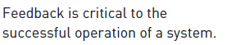
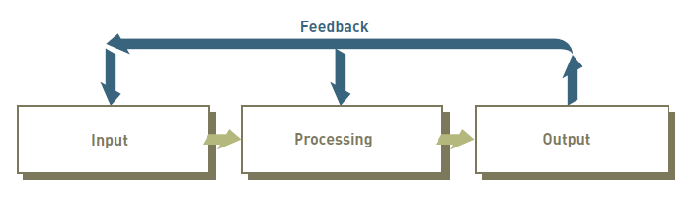
Functions Of Information System
Storage

Slide 29
Functions of system
Input: Activity of gathering and capturing raw data e.g Optical scanning of bar-coded tags on merchandise.
Processing: Converting data into useful outputs for example Calculating employee pay, taxes, and other payroll deductions.
Output: Production of useful information, usually in the form of documents and reports or Producing reports and displays about sales performance
Feedback or Control: Information from the system that is used to make changes to input or processing activities. Generating clear signals to indicate proper entry of sales data
Storage: Maintaining records on customers, employees, and products.

Slide 30
Role Of Information Systems
The vital roles that information systems can perform for a business enterprise.
  Operational excellence (Support of its business processes and operations.)
  New products, services, and business models
  Customer and supplier intimacy
  Improved decision making
  Competitive advantage
  Survival

Slide 31
The vital roles that information systems can perform for a business enterprise
Operational Excellence:
Businesses continuously seek to improve the efficiency of their operations in order to achieve higher profitability. Information systems and technologies are some of the most important tools available to managers for achieving higher levels of efficiency and productivity in business operations, especially when coupled with changes in business practices and management behavior.
For example Customers can press orders, pay online, Information systems can help organization’s employees to record customer purchases, keep track of inventory, pay employees, buy new merchandise, and evaluate sales trends.
  In Uganda, with jumia one can buy items via online.

Slide 32
The vital roles that information systems can perform for a business enterprise
New Products, Services, And Business Models:
Information systems and technologies are a major enabling tool for firms to create new products and services, as well as entirely new business models.
A business model describes how a company produces, delivers, and sells a product or service to create wealth. As successful as Apple, and Wal-Mart were in their traditional brick-and-mortar existence, they have all introduced new products, services, and business models that have made them both competitive and profitable.
    Examples: Apple’s iPod, iPhone, iPad, Google’s Android OS, and Netflix

Slide 33
The vital roles that information systems can perform for a business enterprise
Customer And Supplier Intimacy
When a business really knows its customers, and serves them well, the way they want to be served, the customers generally respond by returning and purchasing more. This raises revenues and profits. Likewise with suppliers:
The more a business engages its suppliers, the better the suppliers can provide vital inputs. Wal-mart is an excellent example of how the use of information systems and technologies are extensively used to better serve their suppliers and retail customers.
The real link system that they use digitally links their suppliers to every one of wal-mart’s 5,289 stores worldwide. Suppliers are able to ensure the continuous flow of products to the stores in order to satisfy customer demands.
Example: High-end hotels that use computers to track customer preferences and use to monitor and customize environment.
Intimacy with suppliers allows them to provide vital inputs, which lowers costs

Slide 34
The vital roles that information systems can perform for a business enterprise
Improved Decision Making
Information systems and technologies have made it possible for managers to use real-time data from the marketplace when making decisions.
Information systems also help managers and other business professionals make better decisions. For example, decisions about what lines of merchandise need to be added or discontinued and what kind of investments they require.
Previously, managers did not have access to accurate and current data and as such relied on forecasts, best guesses, and luck.
The inability to make informed decision resulted in raising costs , Overproduction, underproduction of goods and services, Misallocation of resources, Poor response times, Poor outcomes raise costs and lose customers

Slide 35
The vital roles that information systems can perform for a business enterprise
Competitive Advantage
Delivering better performance, doing things better than your competitors, charging less for superior products, and responding to customers and suppliers in real time all add up to higher sales and higher profits that your competitors cannot match.
Gaining a strategic advantage over competitors requires the innovative application of information technologies. For example, store management might make a decision to install touch-screen kiosks in all stores, with links to the e-commerce Web site for online shopping
  Dell Computers, Apple, and Wal-Mart are prime examples of how these companies used information systems and technologies to separate themselves from their competition. Dell remains the most efficient producer of PCs in the world. Wal-Mart is the most efficient retail store in the industry

Slide 36
The vital roles that information systems can perform for a business enterprise
Survival
Firms also invest in information systems and technologies because they are necessities of doing business. Information system is not a luxury. In most businesses, information systems and technology is the core to survival. Citibank was the first banking firm to introduce ATMs.
In doing so, they had a major competitive advantage over their competitors. In order to remain and survive in the retail banking industry, other banks had no choice but to provide ATM services to banking customers

